Slide 1
Lecture-12: Traversal of Binary Tree
Objectives of this Lecture:
Traversing binary trees:
Preorder traversal
Inorder traversal
Postorder traversal
Threads and threaded trees:
Convert a binary tree to threaded tree

Slide 2
Binary Tree Traversal
In a traversal, each element of the binary tree is visited exactly once.
Many binary tree operations are done by performing a traversal of the binary tree.
Ways of traversing a binary tree:
There are three standard ways to traverse a binary tree. These are:
In-order traversal or Left-Root-Right (LNR) traversal
Pre-order traversal or Root-Left-Right (NLR) traversal
Post-order traversal or Left-Right-Root (LRN) traversal

Slide 3
Binary Tree Traversal
In-order traversal Algorithm (LNR):
Root A
Right Subtree R_{T}
C
Left Subtree L
T
B
D
E
F
To traverse a non-empty binary tree using In-order traversal, we need to perform the following operations:
Traverse the left subtree of R in in-order
Process the root R
Traverse the right subtree of R in in-order
In-order traversal of the above tree is DBEACF

Slide 4
Binary Tree Traversal
Pre-order traversal Algorithm (NLR):
Root A
Left Subtree L_{T}
Right Subtree R
T
B
C
D
E
F
To traverse a non-empty binary tree using Pre-order traversal, we need
to perform the following operations:
Process the root R
Traverse the left subtree of R in pre-order
Traverse the right subtree of R in pre-order
Pre-order traversal of the above tree is ABDECF

Slide 5
Binary Tree Traversal
Post-order traversal Algorithm (LRN):
Root A
Left Subtree L_{T}
B
C
Right Subtree R
T
D
E
F
To traverse a non-empty binary tree using Post-order traversal, we need to perform the following operations:
Traverse the left subtree of R in post-order
Traverse the right subtree of R in post-order
Process the root R
Post-order traversal of the above tree is DEBFCA

Slide 6
Binary Tree Traversal
Note:
Each traversal algorithm has the same three steps.
In each algorithm, the left subtree is always traversed before the right subtree.
Difference between the algorithms is the time at which the root R is processed.
Each algorithm is defined recursively.
When the algorithms are implemented on a computer, a stack will be used.

Slide 7

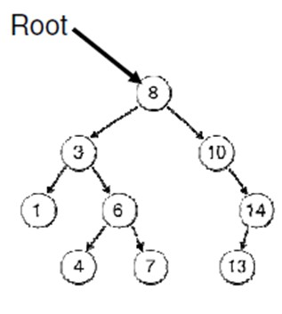
Binary Tree Traversal
Example-1: Consider the binary tree shown in the figure below. Print the value in each node after an:
In-order traversal (LNR)
Pre-order traversal (NLR)
Post-order traversal (LRN)
Answer:
Inorder Traversal: 1, 3, 4, 6, 7, 8, 10, 13, 14
Preorder Traversal: 8, 3, 1, 6, 4, 7, 10, 14, 13
Postorder Traversal: 1, 4, 7, 6, 3, 13, 14, 10, 8

Slide 8
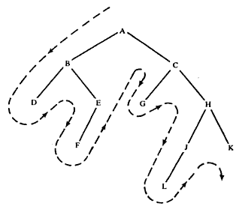
Binary Tree Traversal
Example-2: Consider the binary tree shown in the figure below. Print the value in each node after an:
In-order traversal (LNR)
Pre-order traversal (NLR)
Post-order traversal (LRN)
Answer:
Inorder Traversal: D B F E A G C L J H K
Preorder Traversal: A B D E F C G H J L K
Postorder Traversal: D F E B G L J K H C A

Slide 9
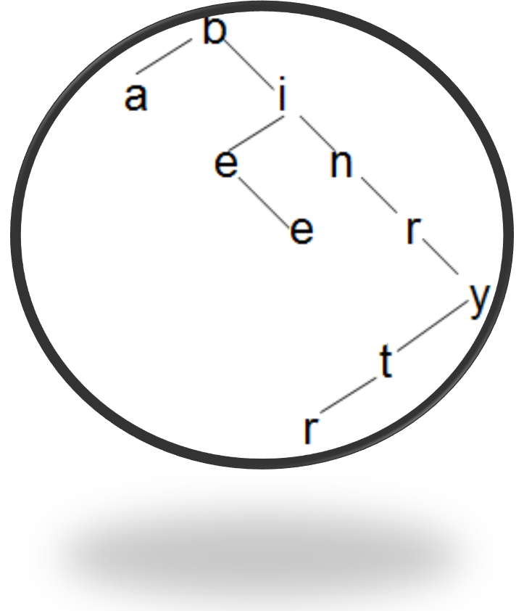
Binary Tree Traversal
Example-3: Consider the binary tree shown in the figure below. Find the traversal of the tree:
In-order traversal (LNR)
Pre-order traversal (NLR)
Post-order traversal (LRN)
Answer:
Inorder Traversal: a b e e i n r r t y
Preorder Traversal: b a i e e n r y t r
Postorder Traversal: a e e r t y r n i b

Slide 10
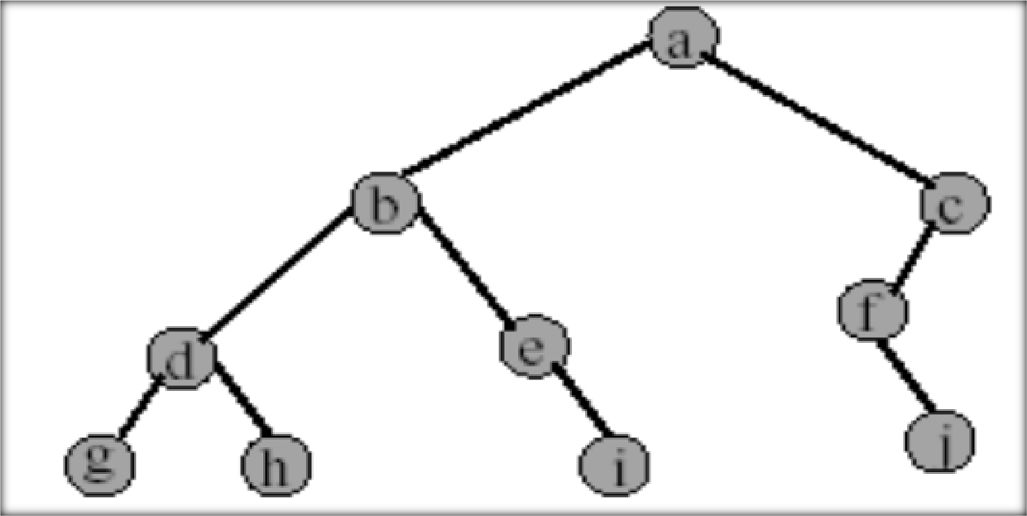
Binary Tree Traversal
Example-4: Find the following traversals for the binary tree shown below.
In-order traversal
Pre-order traversal
Post-order traversal
Pre-order traversal of the tree is: a b d g h e i c f j
Post-order traversal of the tree is: g
In-order traversal of the tree is: g d
h d i e b j f c a
f
h b e i a
j c

Slide 11
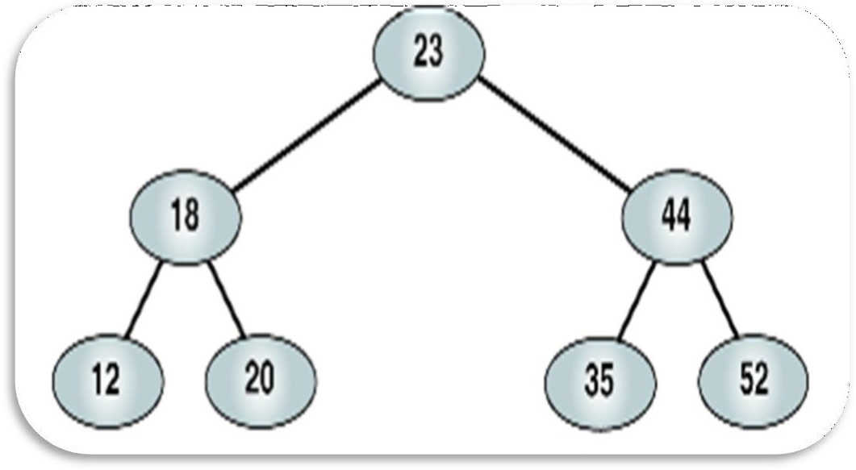
Binary Tree Traversal
Example-5: Find the following traversals of the binary tree shown below.
In-order traversal
Pre-order traversal
Post-order traversal
Pre-order traversal of the tree is: 23 18 12 20 44 35 52
Post-order traversal of the tree is: 12 20 18 35 52 44 23
In-order traversal of the tree is: 12 18 20 23 35 44 52

Slide 12
Binary Tree Traversal
Traversal of Binary Tree Made from Algebraic Expression:
In order to motivate this subject, we introduce the concept of Polish notation.
Given a binary operation ʘ, it is customary to represent the result of applying the operation to two elements a, b by placing the operation symbol in the middle:
a ʘ b [ e.g. a + b]
This is called infix notation.
The Polish or Prefix notation consists of placing the operator symbol to the left i.e. before the two operands:
ʘ a b [ e.g. + a b]
The reverse Polish or Postfix or Suffix notation consists of placing the
operator symbol to the right:
a b ʘ [ e.g. a b + ]

Slide 13
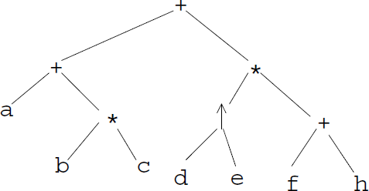
Binary Tree Traversal
Example-6: Given an algebraic expression E = a + b * c + d ↑ e * ( f+ h)
Represent E by means of a binary tree T.
Find the pre-order and post-order traversals of T.
Solution:
The binary tree for this expression is given in figure below.
Pre-order traversal of the tree is:
+ + a * b c * ↑ d e + f h
This is analogous to Polish notation.
Post-order traversal of the tree is
a b c * + d e ↑ f h + * +
This is analogous to Reverse Polish notation.
Figure: Tree for E = a + b * c + d ↑ e * ( f+ h)

Slide 14
Traversal Algorithm Using Stack
Suppose a binary tree T is maintained in memory by some linked representation TREE(INFO, LEFT, RIGHT, ROOT).
Preorder Traversal Algorithm:
This algorithm uses a variable PTR (pointer) which contains the location of the node N currently being scanned. The algorithm also uses an array STACK, which will hold the addresses of nodes for future processing.
Initially push NULL onto STACK and then set PTR:=ROOT. Then repeat the following steps until PTR=NULL or, equivalently, while PTR≠NULL.
Proceed down the left-most path rooted at PTR, processing each node N on
the path and pushing each right child R(N), if any, onto STACK.
The traversing ends after a node N with no left child L(N) is processed.
Thus PTR is updated using PTR:=LEFT[PTR], and the traversing stops when LEFT[PTR]=NULL.
a) [Backtracking] Pop and assign to PTR the top element on STACK. IF PTR≠NULL, then return to Step (a); otherwise exit.

Slide 15
Traversal Algorithm Using Stack
We simulate the preorder traversal algorithm with an example.
Example: Preorder Traversal Algorithm
Consider the binary tree shown in the figure below. Determine the preorder traversal of the tree by simulating the above algorithm.
A
B
C
D
E
F
G
H
K

Slide 16
Traversal Algorithm Using Stack
Solution:
Initially push NULL onto STACK:
STACK: NULL
Then set PTR:= A, the root of the tree.
Proceed down the left-most path rooted at PTR=A as follows:
Process A and push its right child C onto STACK: STACK: NULL, C.
Process B (There is no right child).
Process D and push its right child H onto STACK:
STACK: NULL, C, H.
Process G (there is no right child).
No other node is processed, since G has no left child.
[Backtracking] Pop the top element H from STACK, and set PTR:=H, This
leaves:
STACK: NULL, C.
Since PTR≠NULL, return to Step (a) of the algorithm.

Slide 17
Traversal Algorithm Using Stack
Proceed down the left-most path rooted at PTR=H as follows:
(v) Process H and push its right child K onto STACK: STACK: NULL, C, K.
No other node is processed, since H has no left child.
[Backtracking] Pop the top element K from STACK, and set PTR:=K, This
leaves:
STACK: NULL, C.
Since PTR≠NULL, return to step (a) of the algorithm.
Proceed down the left-most path rooted at PTR=K as follows:
(vi) Process K (There is no right child).
No other node is processed, since K has no left child.
[Backtracking] Pop the top element C from STACK, and set PTR:=C, This leaves:
STACK: NULL.
Since PTR≠NULL, return to step (a) of the algorithm.

Slide 18
Traversal Algorithm Using Stack
Proceed down the left-most path rooted at PTR=C as follows:
Process C and push its right child F onto STACK: STACK: NULL, F.
Process E (There is no right child).
[Backtracking] Pop the top element F from STACK, and set PTR:=F, This leaves:
STACK: NULL.
Since PTR≠NULL, return to step (a) of the algorithm.
Proceed down the left-most path rooted at PTR=F as follows:
(ix) Process F (There is no right child).
No other node is processed, since F has no left child.
11. [Backtracking] Pop the top element NULL from STACK, and set PTR:=NULL. Since PTR=NULL, the algorithm is completed.
As seen from Steps 2, 4, 6, 8 and 10, the nodes are processed in the order A, B, D, G, H, K, C, E, F. This is the required preorder traversal of the given tree.

Slide 19
Threaded Representation of Binary Tree/ Threaded Tree
In linked representation of a binary tree, three important facts are:
the traversal algorithms studied so far spend most of their time manipulating a stack;
the storage space required for the stack is potentially large;
Approximately half of the entries in the pointer fields (LLINK and RLINK) will contain null elements.
The above loss of space and time may be more efficiently handled by replacing the null entries by special pointers called threads which point to nodes higher in the tree.
Binary trees with thread pointers are called threaded trees.
Threaded representation of a binary tree removes the need for a stack, making use of pointer fields which would otherwise have the value nil.
The most common convention for threaded representation is:
if the left subtree is empty, LLINK points to the in-order predecessor
if the right subtree is empty, RLINK points to the in-order successor.
These special pointers are known as threads.

Slide 20
Threaded Representation of Binary Tree/ Threaded Tree
Threads (thread pointers) in a threaded tree must be distinguished in some way from ordinary pointers (LLINK and RLINK).
In the diagram of a threaded tree, threads are usually indicated by dotted lines and ordinary pointers are indicated by solid lines.
While representing a threaded tree in the memory of a computer, an extra 1-bit TAG field may be used to distinguish threads from ordinary pointers, or, alternatively, threads may be denoted by negative integers when ordinary pointers are denoted by positive integers.

Slide 21
Threaded Representation of Binary Tree/ Threaded Tree
Types of Threaded Tree/ Ways to Thread a Binary Tree:
There are many ways to thread a binary tree, but each threading will correspond to a particular traversal of the tree.
One may choose a one-way threading or a two-way threading.
Single Threaded Tree or One-way Threaded Tree:
Here, a thread will usually appear in the right filed (RLINK) of a node and will point to the next node in the inorder traversal of the tree.
Double threaded Tree or Two-way Threaded Tree:
Here, a thread will appear both in the right field (RLINK) and left filed (LLINK) of a node.
The left field thread will point to the next node in the inorder traversal of the tree and the right field thread will point to the preceding node in the inorder traversal of the tree.
In the inorder traversal of the tree, the left pointer field of the first node and the right pointer field of the last node will contain the null value when the tree does not have a header node. But, if the tree has a header node, they will point to the header node.

Slide 22
Threaded Representation of Binary Tree/ Threaded Tree
Example: Binary Tree to Threaded Tree
Consider the binary tree shown in the figure below. Find out the in- order traversal of the tree and make the respective threaded binary tree.
A
B
C
D
E
G
H
F
J
K
L
Figure: A binary tree

Slide 23
Threaded Representation of Binary Tree/ Threaded Tree
One-way inorder thread tree for the given binary tree is shown in the figure below.
There is a thread from node E to node A, since A is accessed after E in
the inorder traversal of the tree.
Observe that every null right pointer has been replaced by a thread except for the node K, which is the last node in the inorder traversal of the tree.
A
B
C
D
E
G
H
F
J
K
L
Figure: One-way inorder thread tree

Slide 24
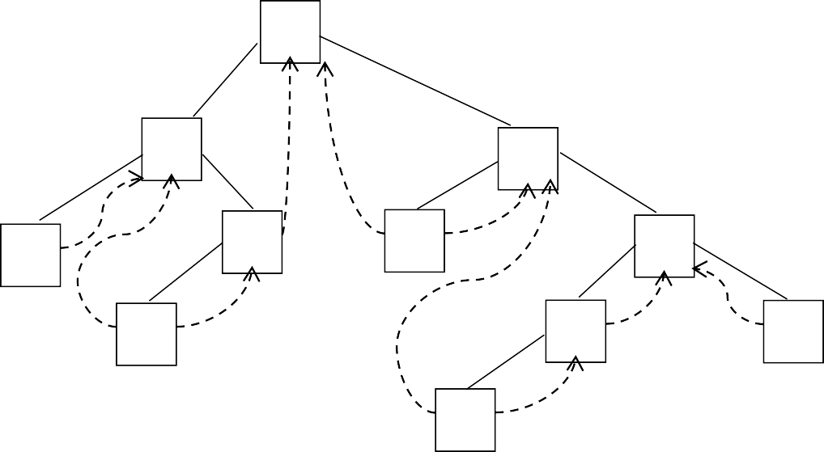
Threaded Representation of Binary Tree/ Threaded Tree
Two-way inorder threaded tree for the given binary tree is shown in the figure below.
There is a left thread from node L to node C, since L is accessed after C in the inorder traversal of the tree.
Observe that every null left pointer has been replaced by a thread except for the node D, which is the first node in the inorder traversal of the tree.
All the right threads are the same as the one-way threads shown in the previous figure.
A
B
C
D
E
G
H
F
J
K
L
Figure: Two-way inorder threaded tree

Slide 25
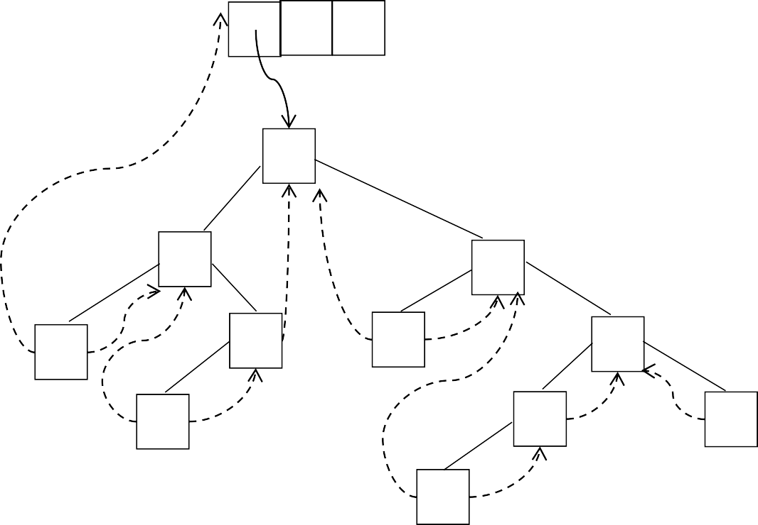
Threaded Representation of Binary Tree/ Threaded Tree
Two-way threaded tree with header node for the given binary tree is shown in the figure below.
Here the left thread of D and the right thread of K point to the header
node.
Header node
A
B
C
D
E
G
H
F
J
K
L
Figure: Two-way threaded tree with header node

